Slide 1


RIMBERIO CO
FEEDBACK SYSTEM
HUMAN COMPOUTER INTERACTION
20BCS152-ADITHYA
20BCS227-RISHIK TEJA
20BCS235-KESAVA RAO
20BCS158-GANGADHAR
20BCS089-HEMANVITHA

Slide 2



RIMBERIO CO
THINGS TO CONSIDER
Children get bored easily, so we gotta design the thing more interactively
their information processing is low
questions should be simple and easy to understand
01
02
03

Slide 3

RIMBERIO CO
THINGS TO CONSIDER
the features we are going to add to make the system interative should not dominate the reviewe system
04
review feedback time should be minimunm
05

Slide 4
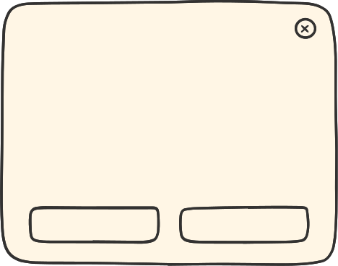
FOR EACH QUESTION
RIMBERIO CO
VOICE OVER FOR EVERY QUESTION
POP UP ANIMATION SHOWING HOW TO ANSWER THE QUESTION

Slide 5


RIMBERIO CO
CONCEPT DESIGN OF BUTTON
ON/OFF
HOW TO DO
Button to on/off the device
button to explain what to do visually and verbally

Slide 6

REVIEW FORMAT OF QUESTIONS

Slide 7

we will display the photo, name and the subject of the teacher

Slide 8


FOR YES OR NO QUESTIONS
THEIR WILL BE 2 BUTTERFLIES ONE TO THE LEFT AND ONE TO THE RIGHT
IF THE CHILD ANS IS YES HE WILL COLOR THE RIGHT ONE OR ELSE THE LEFT ON E
THE ABOVE BUTTERFLY IS A PART OF A BIGGER PICTURE WHICH WILL BE FORMED AT THE END OF THE FEEDBACK REVIEW

Slide 9

FOR RATING QUESTIONS
GOOD
AVERAGE
BAD
INSTEAD OF USING TRADITIONAL RATING SYSTEM
WE ARE USING EMOJIS

Slide 10
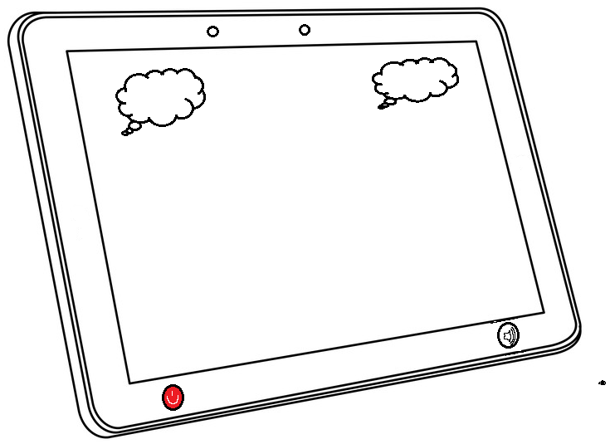
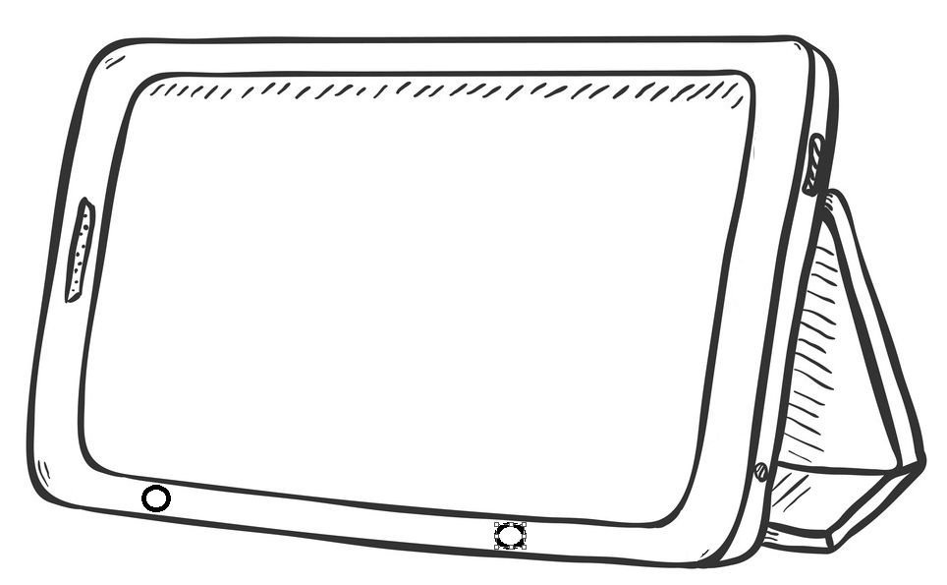
THE BASIC DESIGN
FOR EASE OF HOLDING

